Slide 1
ANALYSIS REPORT ON BANK CHURNERS
Presented by
Anusree Vinod
Irfana Fasila K
Keerthana C
Sherlin Daison
Rahul K Ravindran
Aleena Shaju

Slide 2
INTRODUCTION
The phenomenon of customer churn, where in customers discontinue their relationship with a bank, poses a significant challenge, not only in terms of revenue loss but also in maintaining market competitiveness.
This report delves into the analysis of bank churners, aiming to unearth insights into the characteristics, behaviors, and patterns associated with customers who churn. By leveraging advanced analytical techniques and comprehensive data sets, this analysis seeks to provide actionable intelligence to mitigate churn and enhance customer retention efforts.

Slide 3
ABOUT DATASET
The dataset selected contains the customer data of account holders at a particular Bank and the aim of the data will be predicting the Customer Churn.This dataset consists of 10127 rows and 21 columns.
Number | Attribute | Description
1 | CLIENTNUM | Unique identifier for each customer.(Integer)
2 | Attrition Flag | Flag indicating whether or not the customer has churned out.(Boolean)
3 | Customer Age | Age of customer.(Integer)
4 | Gender | Gender of the customer.(String)
5 | Dependent count | Number of dependents that the customer has.(Integer)
6 | Education Level | Education level of customer.(String)

Slide 4
7 | Marital Status | Marital status of customer.(String)
8 | Income Category | Income category of customer.(String)
9 | Card Category | Type of card held by the customer.(String)
10 | Months on book | How long customer has been on the books?(Integer)
11 | Total Relationship Count | Total number of relationships the customer has with the credit card provider.(Integer)
12 | Months Inactive 12_mon | Number of months the customer has been inactive in the last twelve months.(Integer)
13 | Contacts Count 12_mon | Number of contacts the customer has had in the last twelve months.(Integer)
14 | Credit Limit | Credit limit of customer.(Integer)
15 | Total Revolving Bal | Total revolving balance of the customer.(Integer)
16 | Avg Open To Buy | Average open-to-buy ratio of customers.(Integer)
17 | Total Amt Chng Q4 Q1 | Total amount changed from quarter 4 to quarter 1.(Integer)

Slide 5
18 | Total Trans Amt | Total amount changed from quarter 4 to quarter 1.(Integer)
19 | Total Trans Ct | Total transaction count.(Integer)
20 | Total Ct Chng Q4_Q1 | Total count changed from quarter 4 to quarter 1.(Integer)
21 | Avg Utilization Ratio | Average utilization ratio of customers.(Integer)

Slide 6
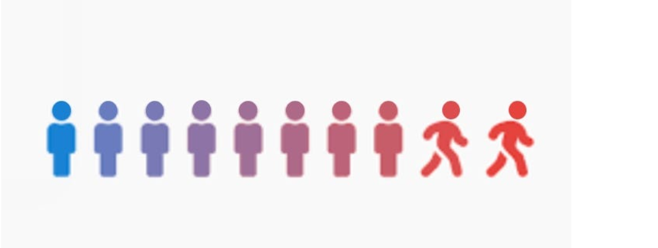
OBJECTIVE
Churn Reason: Identify the different reasons why customers leave the bank.
Churn Reduction: Provide solutions to reduce the rate at which customers leave the bank.

Slide 7
PREPROCESSING
Data preprocessing is a crucial step in preparing raw data for analysis. It encompasses various challenges such as ensuring data quality, integrating different datasets, performing feature engineering, reducing dimensionality, scaling features, managing imbalanced data, identifying outliers, improving time-series data, and addressing data privacy concerns. These tasks are essential for organizing and refining the data to ensure accurate and reliable outcomes. Since the dataset under consideration is likely sourced from banks' credit card portfolios, it is probably structured.Thel preprocessing steps involved to enhance the data's usability and effectiveness are:
STEP 1: Checking for missing values
Since this data is about bank customers, it is most likely structured. As a result, after verification, the dataset contains no missing values.
STEP 2: Checking for duplicate values
There are no duplicate values in the dataset.
STEP 3: Feature selection
Due to the fact that the Client number and marital status attribute in the dataset is optional for customer churn analysis, it can be eliminated, resulting in a total of 19 columns after feature selection.

Slide 8
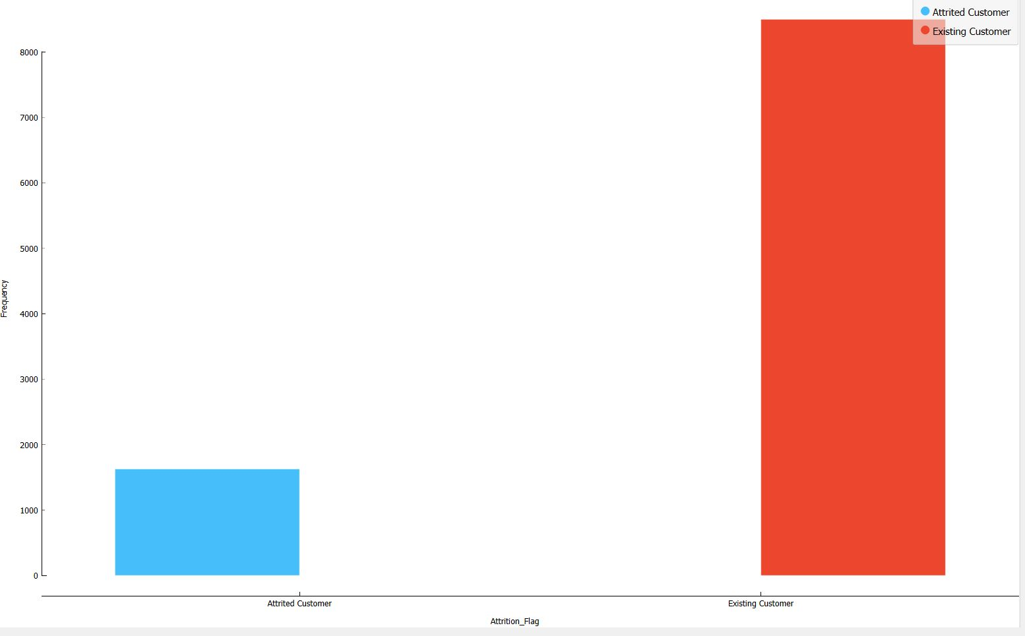
Visualization
Data visualization is the representation of data in graphical or pictorial form, using charts, graphs, and other visual elements. The purpose of data visualization is to make complex data more accessible, understandable, and useful to people who need to analyze and interpret it. By visually presenting data, it becomes easier to identify patterns, trends, and relationships between different data points.
Count Plot

Slide 9
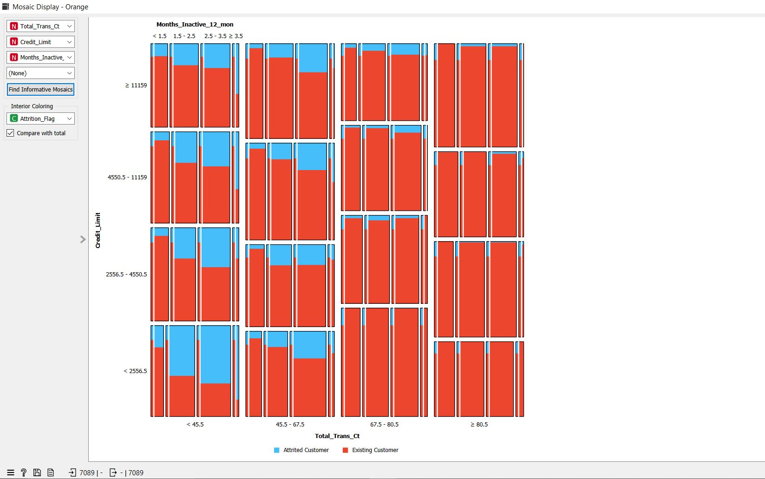
Inactivity of month v/s Attrition Flag

Slide 10
Analysis of Mosaic plot
From the dataset, it's evident that there's a high correlation between credit limit and transaction count. By utilizing these attributes along with attrition status as key values, we created a mosaic graph. It revealed that over 50% of individuals are leaving the bank despite having lower transaction counts and less credit control. One significant factor contributing to this attrition is the months of inactivity. When we added this factor into the mosaic plot, it became apparent that customers inactive for 2-3 months are more likely to leave the bank.
Conclusion
We can see that whenever the inactivity of the customer using a credit card increases the ratio of Attrition customer to overall customer increases which means inactivity is directly proportional to attrition.
Solution
To address this attrition issue, it's recommended to monitor the inactivity of customers for more than 1.5 months. If they remain inactive, proactive measures such as contacting them or providing credit card offers could be implemented.

Slide 11
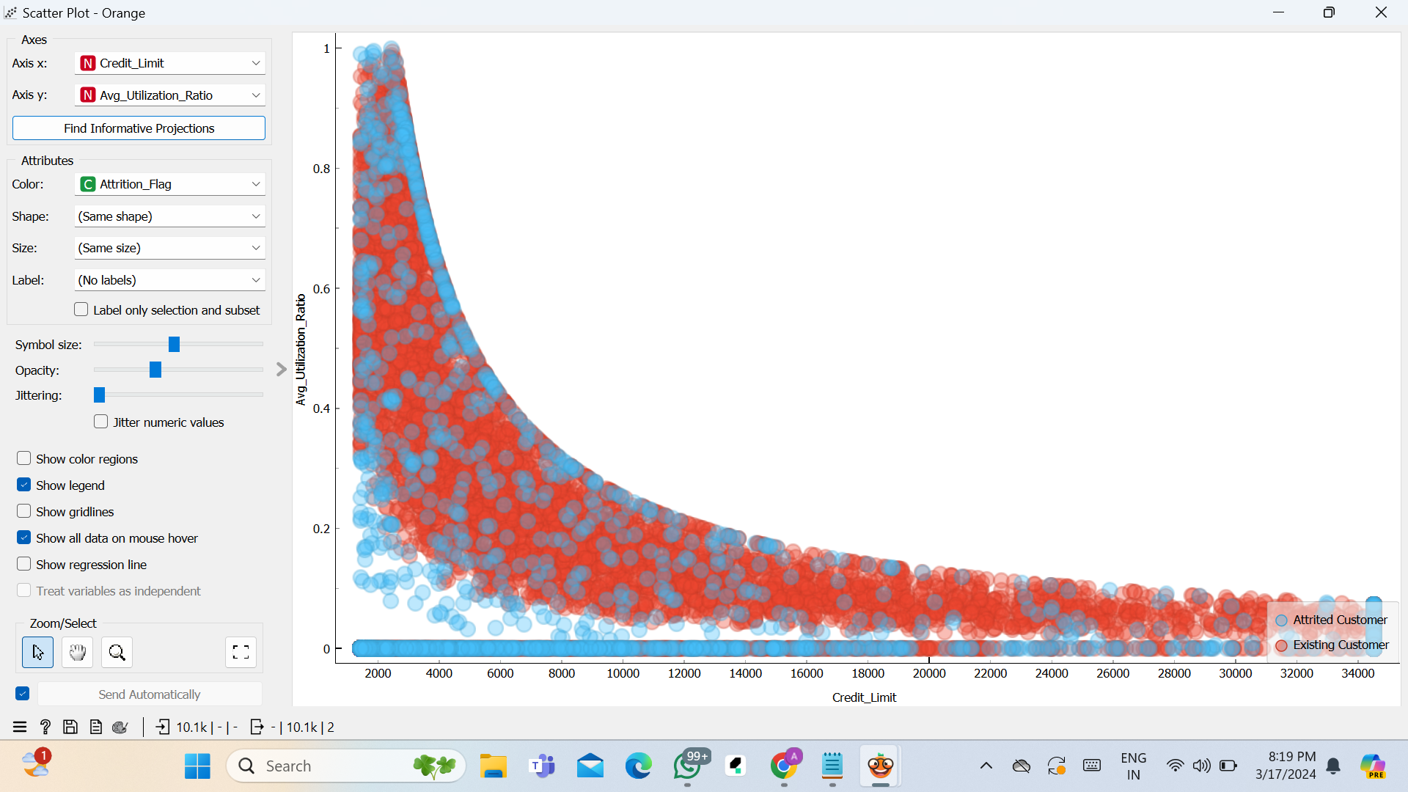
Scatter Plot
Credit_Limit V/S Avg_Utilization_Ratio

Slide 12
Analysis of Scatter plot
Create a scatter plot with Credit_Limit on the x-axis and Avg_Utilization_Ratio on the y-axis.
Color code the points based on Attrition_Flag to differentiate between churned and retained customers.
Churned Customers (attitired customers)
Retained Customers (existing customers)
Conclusion
Assess if customers are managing their credit responsibly or if there are signs of financial strain based on their utilization patterns.
Higher levels of Avg_Utilization_Ratio among customers may indicate that customers who utilize a larger portion of their credit limits are more likely to attire.
Customers with lower Credit_Limit and high Avg_Utilization_Ratio may represent a segment at higher risk of churn due to potential financial strain or dissatisfaction.
Solution
Targeted Customer Engagement
Identify customers with high Avg_Utilization_Ratio and low Credit_Limit who are at higher risk of attire.
Proactively engage with these customers through personalized communication, offering financial advice, and promoting products/services that suit their needs.
For high-risk customers with high Avg_Utilization_Ratio and low Credit_Limit, evaluate the possibility of offering credit limit increases cautiously to mitigate attire risk.

Slide 13
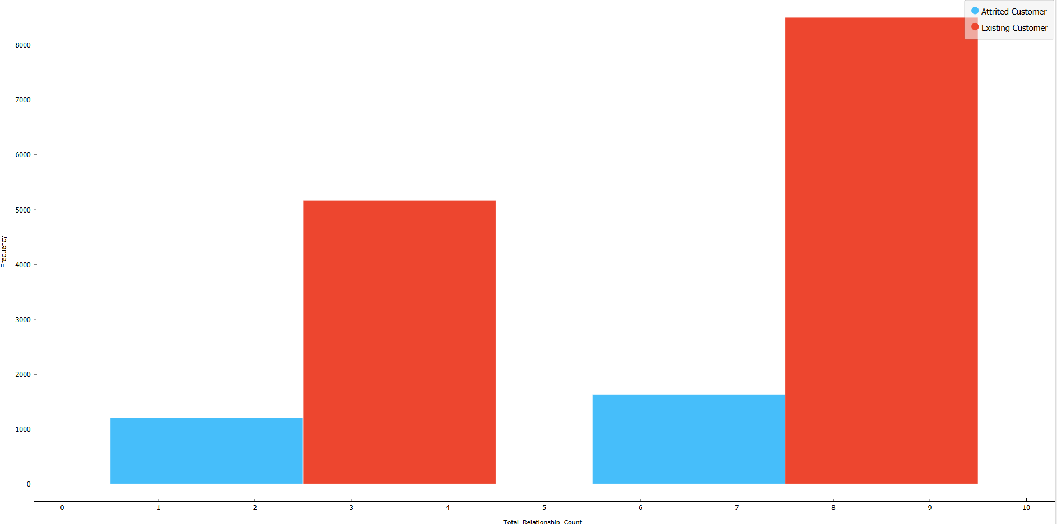
Attrition flag v/s Relationship count

Slide 14
Analysis of Distribution
From the chart, it is clear that customers with five total relationships with the bank have a high retention rate; a significant majority remain as Existing Customers. In particular, 81.10% of customers with five relationships are still with the bank, while only 18.90% have attrited. This suggests that engagement with multiple products or services is a strong indicator of customer loyalty.
Conclusion
The visual evidence implies that the number of relationships a customer has with the bank is inversely proportional to their likelihood of attrition. Customers engaged with more bank services or products tend to remain with the bank, indicating that a diversified relationship between the bank and its customers may lead to higher retention rates.
Solution
1.Bundle services for savings.
2.Reward loyal customers with perks.
3.Suggest personalized products.
6.Educate on benefits of using more services.
7.Simplify process to add new services.

Slide 15
Model Building
Data modeling in data mining involves creating mathematical representations or structures that capture relationships and patterns within a dataset, facilitating the extraction of insights and predictions. It encompasses techniques such as regression, clustering, classification, and association to uncover hidden patterns and make informed decisions.
Classification:
Supervised learning method.
Assigns predefined labels or categories to new data based on learned patterns from labeled training data.
Predictive Modeling: The primary objective of classification is to build predictive models that accurately classify new instances into predefined categories based on input features.
Pattern Recognition
Risk Assessment
Decision Making
Clustering:
Unsupervised learning method.
Groups similar data points together based on inherent similarities.
Prediction:
Involves forecasting numerical values based on historical data.
Utilizes various regression techniques to estimate future outcomes.

Slide 16
Classification
Here we classify the dataset using 4 types of classification models,they are
Naive Bayes classification model
Probabilistic classifier based on Bayes' theorem.
Assumes independence among features.
K-Nearest Neighbors (KNN) classification model
Instance-based algorithm that classifies data based on similarity to nearby neighbors.
No explicit model training phase, just stores the training data.
Random Forest classification model
Ensemble learning method based on decision trees.
Builds multiple decision trees and combines their predictions through voting or averaging.
Robust against overfitting and capable of handling high-dimensional data.

Slide 17
Support Vector Machine (SVM) classification model
Supervised learning algorithm that finds the optimal hyperplane to separate data into different classes.
Effective in high-dimensional spaces and when the number of features exceeds the number of samples.
Versatile, with various kernel functions to handle nonlinear relationships.
For classification here we set our target variable as Attritian_flag(Existing customer,attrited customer),and classify preprocessed dataset.

Slide 18
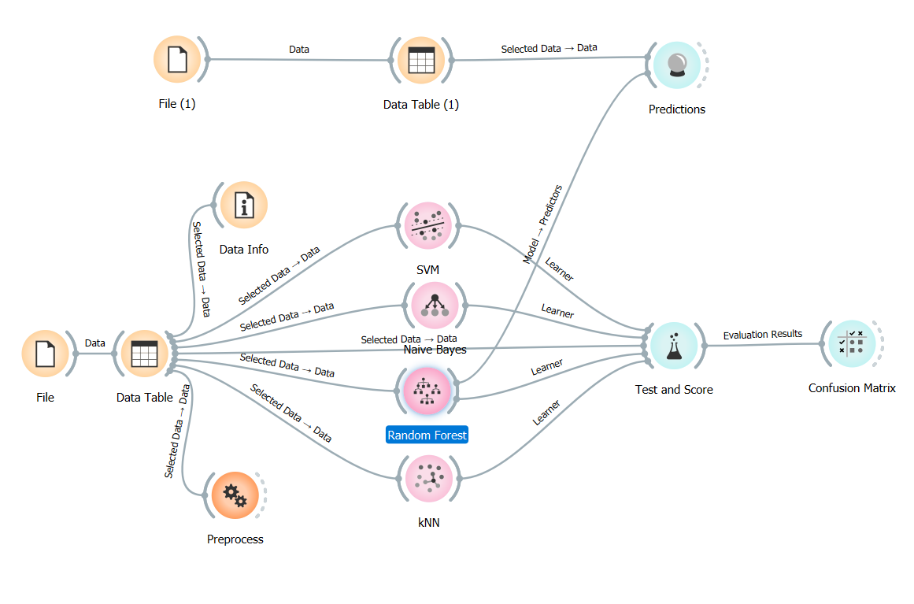

Slide 19
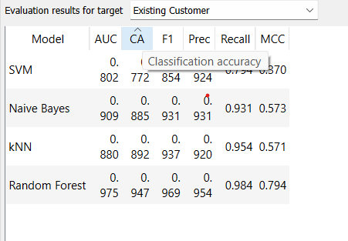
While comparing with svm,Naive bayes and kNN, Random forest shows more accuracy,hence we select the Random forest as our Model.

Slide 20
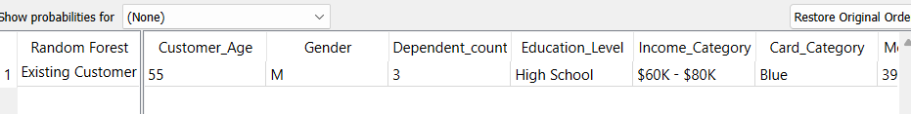
So,using Random Forest classification model we predict the testing data .
So,we tried predicting the target of one of the tuple from the dataset and it gives accurate result.

Slide 21
Prediction
Prediction to the process of using historical data to forecast future outcomes or trends. It involves applying statistical algorithms and machine learning techniques to analyze patterns in data and make educated guesses about what might happen next. Prediction helps businesses and researchers anticipate future events, make informed decisions, and plan for various scenarios.
Prediction Methods
Linear Regression
Logistic Regression

Slide 22
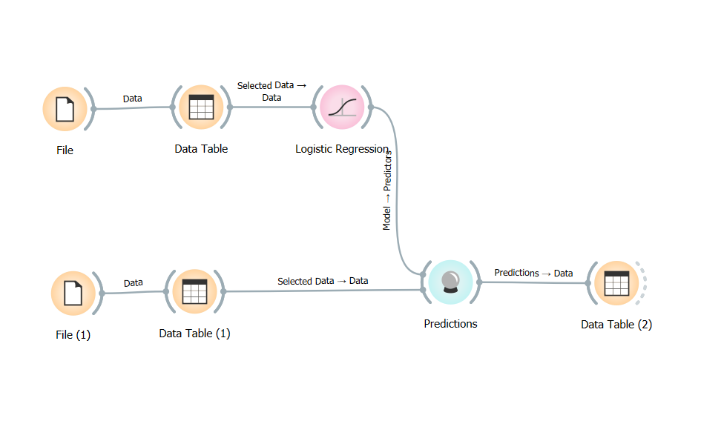

Slide 23
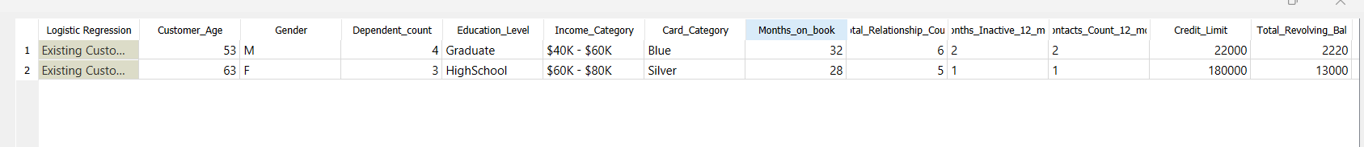
So when a new data is being given it predicted the value of attrition flag as existing customer using the logistic regression method.

Slide 24
Conclusion
This project focused on analyzing the customer churn in a bank through various stages of data preprocessing, visualization, analysis, and model building.
Objective of Our Model:
Churn Reason: Identify the different reasons why customers leave the bank.
Churn Reduction: Provide solutions to reduce the rate at which customers leave the bank.
Data Preprocessing:
We began by addressing critical steps such as checking for missing and duplicate values, and performing feature selection to refine our dataset for analysis. These steps ensured that our data was clean, complete, and relevant for the subsequent stages of our project.

Slide 25
Visualization and Analysis:
By using techniques like mosaic plots, scatter plots, and sieve diagrams, we learned important things about why customers might stop using banking services. We found patterns and trends that helped us understand customer behavior better and predict when customers might leave the bank.
Model Building:
In the model building phase, we explored various classification algorithms including Naive Bayes, K-Nearest Neighbors (KNN), Random Forest, and Support Vector Machine (SVM). After thorough evaluation, we selected Random Forest as our preferred model due to its superior accuracy and robustness.

Slide 26
Prediction:
Using the Random Forest model, we successfully predicted the attrition status of customers based on historical data. Logistic Regression was also employed to forecast the attrition flag for new data instances, providing valuable insights for proactive customer retention strategies.
Overall Implications:
Our analysis underscores the critical importance of data cleaning, visual understanding, and predictive modeling in identifying potential customer churn within the banking sector. By employing these techniques, companies can pinpoint customers at risk of leaving their bank services. By doing these things, companies can figure out which customers might leave and then come up with plans to keep them happy and improve their banking services.
Future Directions:
Looking ahead, we can improve our analysis by adding more data, making our prediction models better, and always watching how customers behave. By being ready to change and learning from what we see, companies can effectively manage customer churn in the banking sector and ensure long-term customer satisfaction and loyalty.

Slide 27
THANK YOU

